Slide 1
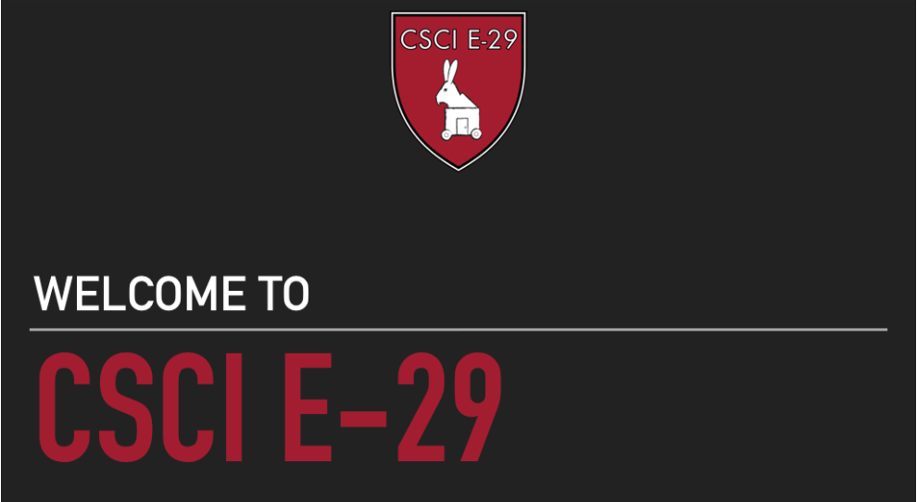

Slide 2


Slide 3
APIs and Libraries Used
Blue Alliance API
Functools
Requests
Numpy
Pandas
Scipy
Sklearn
Optunity
Seaborn

Slide 4
Helper Functions

Slide 5
Offensive Player Rating (OPR)
Defensive Player Rating (DPR)
Calculated Contribution to Winning Margin (CCWM)

Slide 6
Preparing the Data

Slide 7
Machine Learning Models

Slide 8
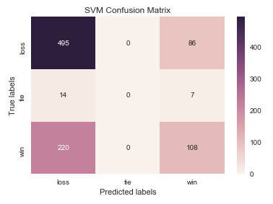
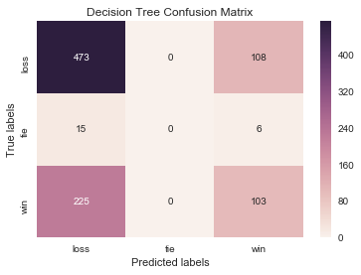
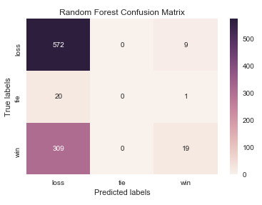

Slide 9
A + B + C = 100
A + C + D = 130
B + C + E = 70
A + B + D = 150
B + D + E = 60

Slide 10
A + B + C = 100
A + C + D = 130
B + C + E = 70
A + B + D = 150
B + D + E = 60
A + B + C = 100
A + C + D = 130
A + B + D = 150
3A + 2B + 2C + 2D = 380
+

Slide 11
2 2 2 0 A 380
B
C
D
E
3A + 2B + 2C + 2D = 380

Slide 12
2 2 2 0 A 380
4 2 2 2 B 380
2 3 1 1 C 300
2 1 3 1 D 340
0 2 1 1 2 E 130
Mx = s

Slide 13
2 2 2 0 A 380
4 2 2 2 B 380
2 3 1 1 C 300
2 1 3 1 D 340
0 2 1 1 2 E 130
Mx = s
OPR = scipy.sparse.linalg.lsqr(M,s)[0]

